Slide 1
Section 3

Slide 2

1- Soft Skills
Soft skills are generally picked up through life experience such as:
Communicate and work with others
Making decisions
Organize yourself and work
Adapt to difficult situations

Slide 3
1- Soft Skills
Communication:
Writing E-mails
Dealing with Customers
Reading instructions
Helping people

Slide 4
1- Soft Skills
Leadership
Time Management
Problem Solving
Mentoring

Slide 5
1- Soft Skills
Positivity
Stay calm in stressful situations
Look for answers to problems
Have a can-do attitude

Slide 6
1- Soft Skills
Flexibility
Covering someone else’s duties at work
Working outside of your regular hours

Slide 7
1- Soft Skills
Problem Solving
Dealing with a customer’s problem
Doing research to understand a situation
Asking questions to help you understand the bigger picture

Slide 8
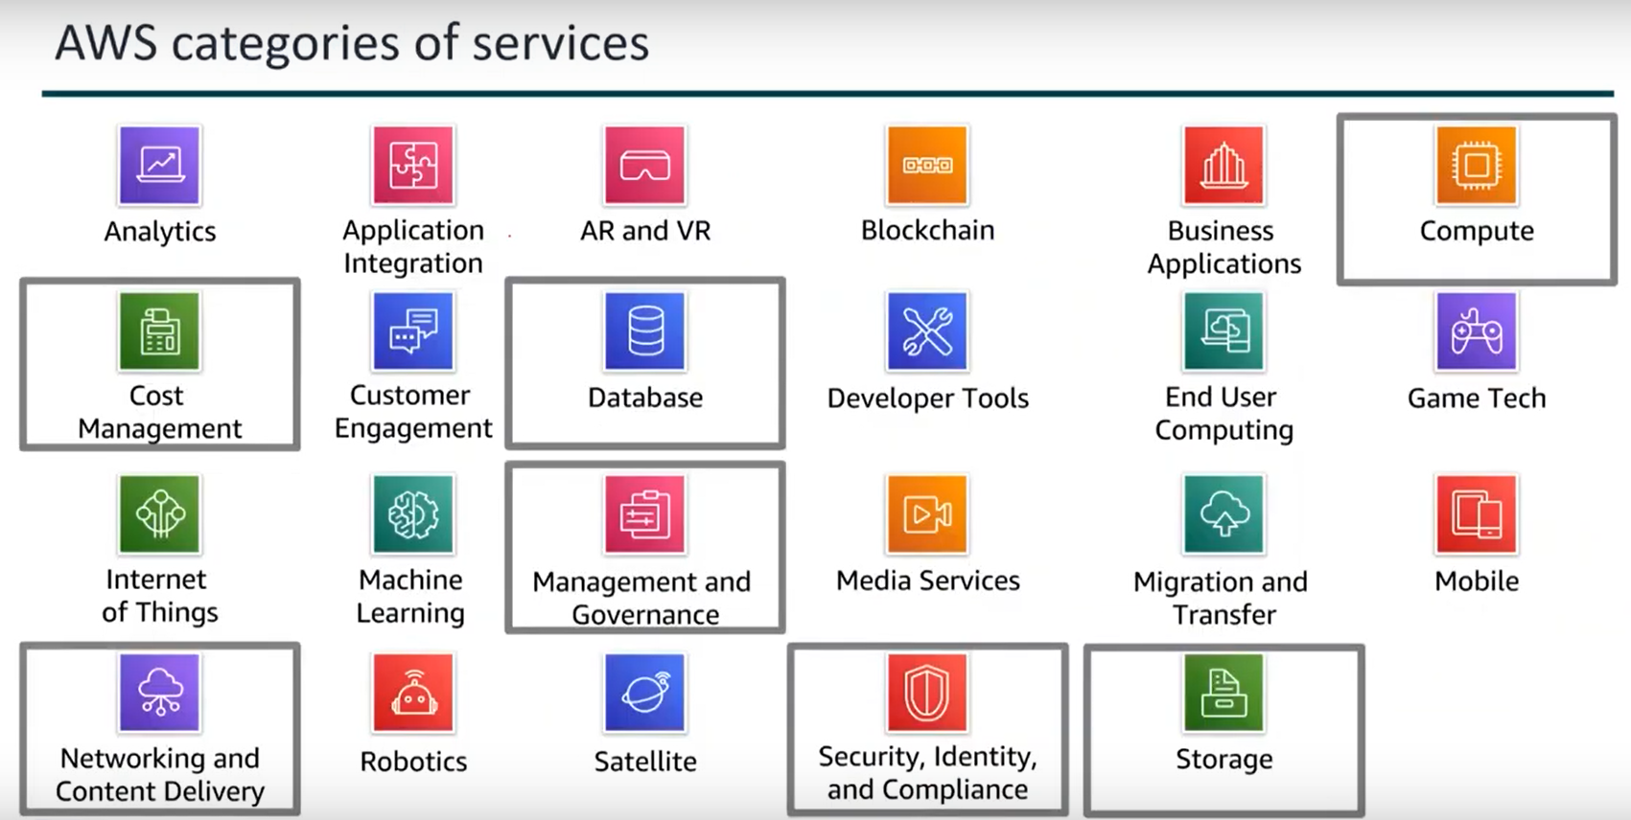

Slide 9
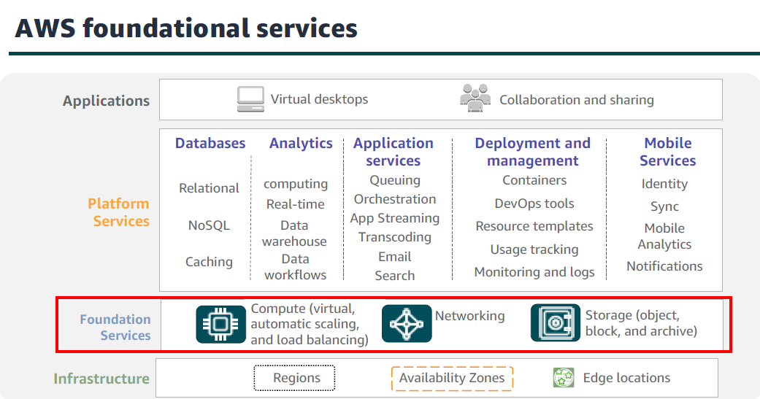

Slide 10
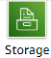
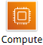
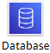
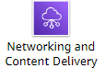
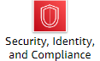
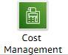
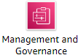
2- AWS Services and Service Category
Some of AWS Service Categories

Slide 11
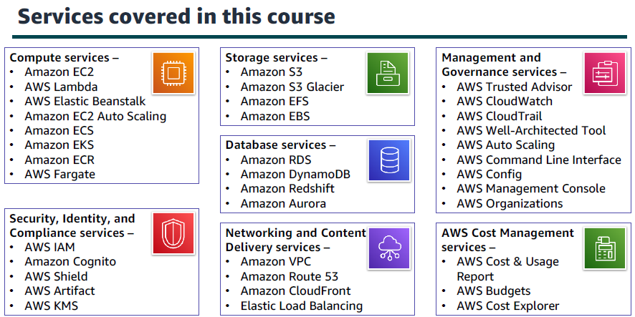
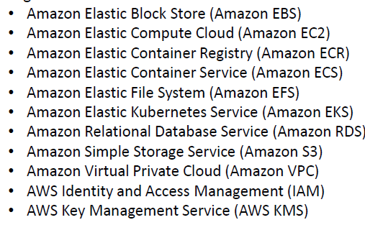

Slide 12
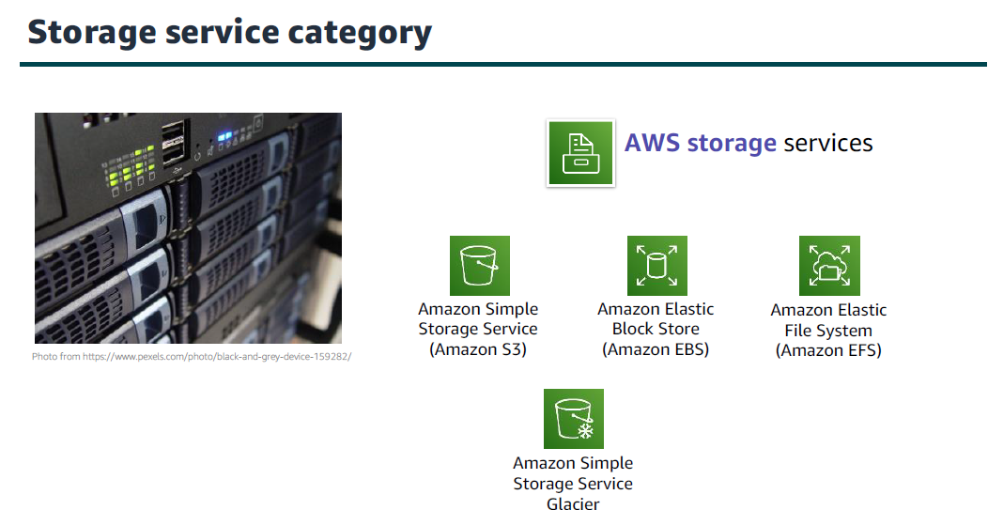

Slide 13
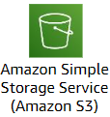
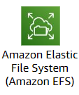
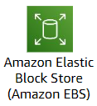
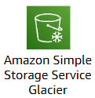
2- AWS Services and Service Category
Storage Service Category
S3 (Simple Storage Service): Object storage service that offers scalability, data availability, security, and performance for storing and retrieving any amount of data
EFS (Elastic File System): is a fully managed, scalable file storage service that allows you to easily share file data across multiple Amazon EC2 instances and on-premises servers.
EBS (Elastic Block Store): Provides block-level storage volumes for use with EC2, allowing for durable storage of data with high performance.
Glacier: A low-cost cloud storage service for data archiving and long-term backup, optimized for infrequent access.

Slide 14
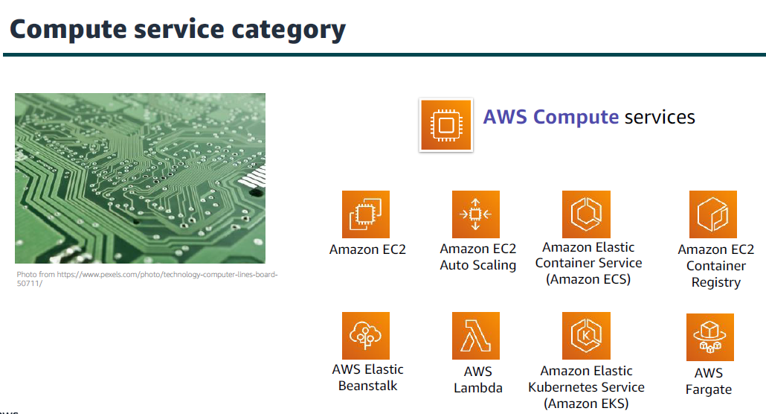

Slide 15
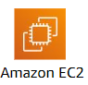
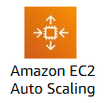
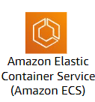
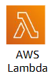
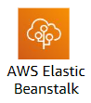
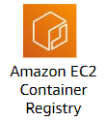
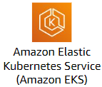
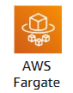
2- AWS Services and Service Category
Compute Service Category
EC2: Virtual servers for running applications in the cloud.
EC2 Auto Scaling: Automatically adjusts the number of Amazon EC2 instances
Lambda: Run code without managing servers.
ECS: Manage and scale Docker containers easily.

Slide 16
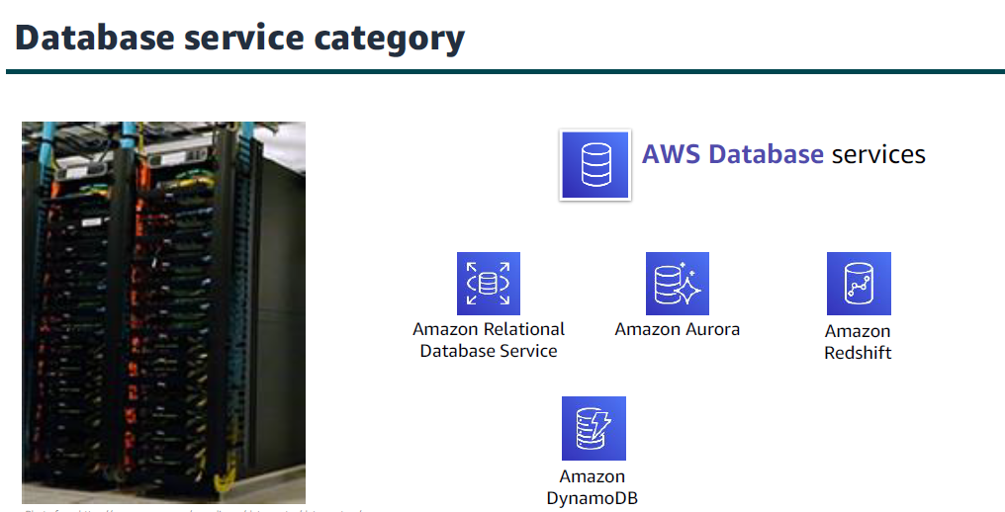

Slide 17
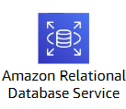
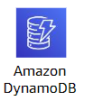
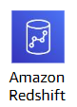
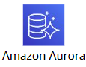
2- AWS Services and Service Category
Database Service Category
DynamoDB: Fast NoSQL database with seamless scaling.
RDS: Managed relational databases in the cloud.
Amazon Redshift: A fully managed, petabyte-scale data warehouse service that allows for fast and scalable analytics on large datasets
Aurora: High-performance MySQL/PostgreSQL database.

Slide 18
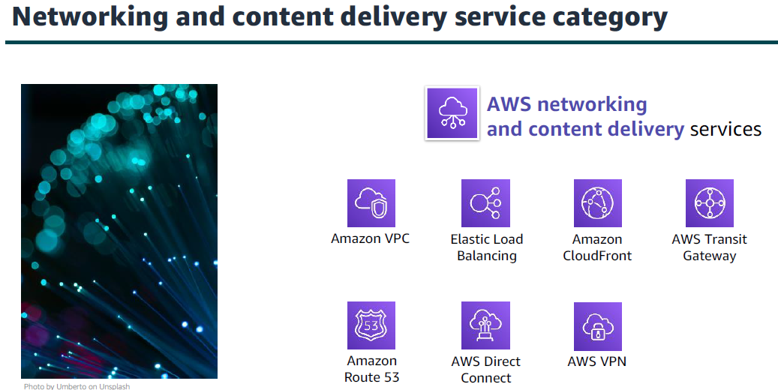

Slide 19
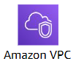
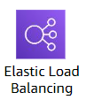
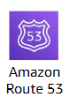
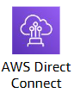
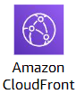
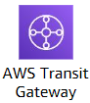
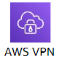
2- AWS Services and Service Category
Networking and Content Delivery Service Category
VPC: Create isolated networks for your AWS resources.
A service that automatically distributes incoming application traffic across multiple targets, such as EC2 instances.
Route 53: Scalable DNS and domain registration service.
Establishes a dedicated network connection between your on-premises data center and AWS

Slide 20
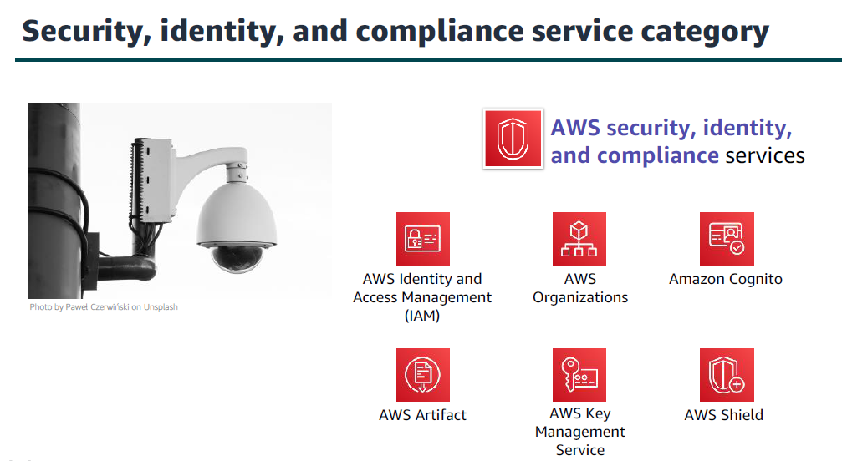

Slide 21
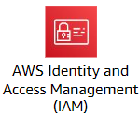
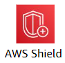
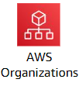
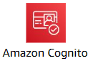
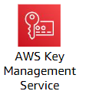
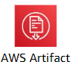
2- AWS Services and Service Category
Security, identity, and compliance Service Category
IAM: Control access to AWS services for users.
AWS Shield: Protect against DDoS attacks.
AWS Organizations: a service that enables you to centrally manage multiple AWS accounts
AWS Cognito: A user authentication and management service that enables developers to add sign-up, sign-in, and access control features to their applications

Slide 22
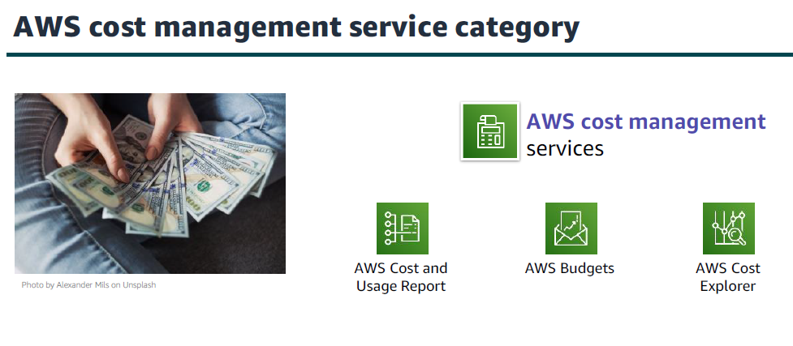

Slide 23
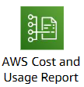

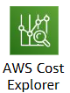
2- AWS Services and Service Category
AWS Cost Management Service Category
Provides detailed information about your AWS costs and usage
Set custom cost and usage budgets to monitor your spending and receive alerts when you exceed thresholds.
Visualize, understand, and manage your AWS costs and usage over time with interactive graphs and reports.

Slide 24
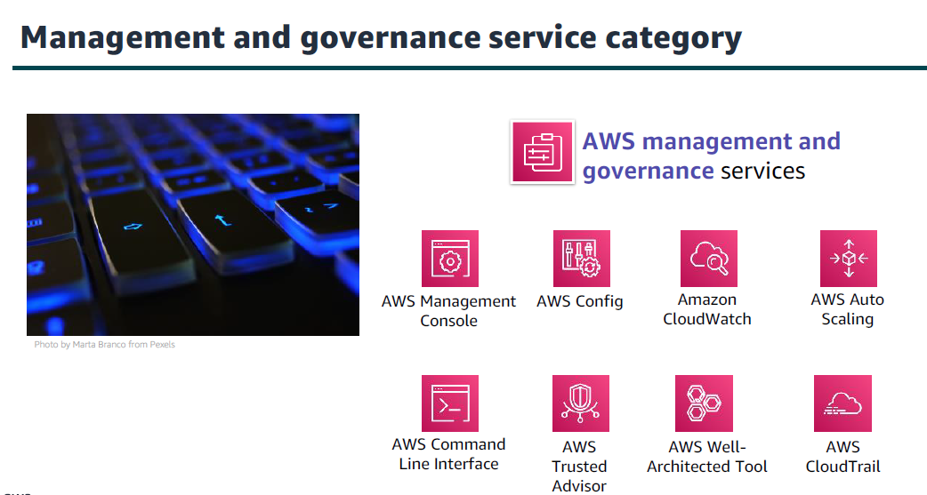

Slide 25
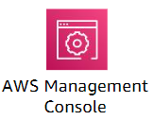







2- AWS Services and Service Category
Management and Governance Service Category
A web-based graphical interface that allows users to interact with AWS services.
Amazon CloudWatch: Monitor resources and applications.
AWS CLI: A tool that allows you to manage AWS services and resources through command-line commands
AWS Trusted Advisor: Helps you optimize performance and security.

Slide 26


Slide 27


Slide 29


AWS SERVICES
Notes:
AWS Management Console is a simple and intuitive user interface

Slide 30


Slide 31


Slide 32


Region Election

Slide 33



Slide 34


Slide 35


Slide 36


Slide 37
Availability Zones.
one or more discrete DC with redundant power, networking, and connectivity in an AWS Region·
AZs make applications partitioning for high availability easy to better isolate and protect from issues such as power outages, lightning strikes, tornadoes, earthquakes, and more·
AZs are physically separated by many kilometers, from any other AZ, although all are within 100 km

Slide 38


Slide 39


Slide 40


Slide 41


Slide 42


Slide 43



Slide 44


Slide 45


Slide 46



Slide 47


Slide 48



Slide 49
Region Selection Criteria
Compliance and regulations
Proximity
Services Availability
Cost $

Slide 50


Slide 51


Slide 52


Slide 53


Slide 54


Slide 55

3- AWS Management Console
Console Home Page

Slide 56

3- AWS Management Console
Account Information

Slide 57

3- AWS Management Console
Region Selection, some services are global and some are regional

Slide 58

3- AWS Management Console
Search for a service

Slide 59

3- AWS Management Console
IAM is a Global Service

Slide 60

3- AWS Management Console
EC2 is a Regional Service

Slide 61


Slide 62


Slide 63


Slide 64


Slide 65


Slide 66


Slide 67


Slide 68
Questions
1-IAM Service is a Regional Service
True
False
Notes:
B. False

Slide 69
Questions
2-IAM Service is a Service in:
Networking and Content Delivery Service Category
Storage Service Category
Security, identity, and compliance Service Category
Compute Service Category
Notes:
C. Security, identity, and compliance Service Category

Slide 70
Questions
3-Which of the Following Services is a Storage Service?
EC2
Amazon S3
Route 53
AWS Organizations
Notes:
B. Amazon S3

Slide 71
Questions
4-Which of the Following Services is a Compute Service?
EC2
Amazon S3
Route 53
AWS Organizations
Notes:
A. EC2

Slide 72
Questions
5- EC2 is a Regional Service?
True
False
Notes:
A. True

Slide 73
Questions
6- A regional service is a service that operates across multiple regions or have a global presence.
True
False
Notes:
B. False

Slide 74
Questions
7- Which of the following services is used to control access to AWS services for users
EC2
Amazon S3
IAM
AWS Organizations
Notes:
C. IAM

Slide 75
Questions
8- Which of the following services is used to protect against DDoS attacks.
AWS Cognito
AWS Shield
IAM
Amazon CloudWatch
Notes:
B. AWS Shield

Slide 76

Notes:
AWS Edge locations

Slide 77

Notes:
Decrease

Slide 78

Notes:
True

Slide 79

Notes:
AWS Regions

Slide 80

Notes:
Fault-tolerant, elastic and scalable

Slide 81

Notes:
True

Slide 82

Notes:
A data center can be used for more than one availability zone

Slide 83

Notes:
A region is a physical location that has multiple availability zones
Each region is located in a separate geographic area

Slide 84

Notes:
multiple

Slide 85

Notes:
false

